Slide 1
Biology
Unit 1: The Living Systems
Lesson 2: Organisms: Cells to Body Systems
Notes:
The learning experiences in this unit prepare students for the mastery of
Performance Expectations
LS1-2 Develop and use a model to illustrate the hierarchical organization of interacting systems that provide specific functions within multicellular organisms.
LS1-3 Plan and conduct an investigation to provide evidence that feedback mechanisms maintain homeostasis.
ETS1-2 Design a solution to a complex real-world problem by breaking it down into smaller, more manageable problems that can be solved through engineering.
ETS1-3 Evaluate a solution to a complex real-world problem based on prioritized criteria and trade-offs that account for a range of constraints, including cost, safety, reliability, and aesthetics, as well as possible social, cultural, and environmental impacts.

Slide 2


Can You Explain It?
Unit 1 Lesson 2
How do you think systems within your body interact to produce sensations like "butterflies" in your stomach?
A ballerina awaits her cue backstage.
Notes:
Build on Prior Lessons
In Lesson 1, students learned about the properties of systems and explored living and nonliving system models. Lesson 2 builds on these concepts as students explore living systems in greater detail.
Lesson Objective
Use a model to explain how systems within an organism interact at different levels to carry out functions necessary for life.

Slide 3
Unit 1 Lesson 2
Interacting Systems in Organisms
An organ system is two or more organs that work together to perform body functions.
Organ systems interact to help the organism maintain internal stability, or homeostasis.
According to the model of the human respiratory system, how do structures in the respiratory system interact to protect the lungs?
How might a sinus infection affect the rest of the respiratory system?

Slide 4
Unit 1 Lesson 2
Interacting Systems in Organisms
ANALYZE
If a person’s circulatory system did not function properly, how might other systems, such as the respiratory and digestive systems, be affected?
How would homeostasis, or internal stability, be affected by these system imbalances?

Slide 5

Interacting Systems in Organisms Hands-On Lab: Connecting Form to Function
Unit 1 Lesson 2
Examine a slice of the roots, stems, and leaves of a plant to explain how their structures relate to their functions.

Slide 6
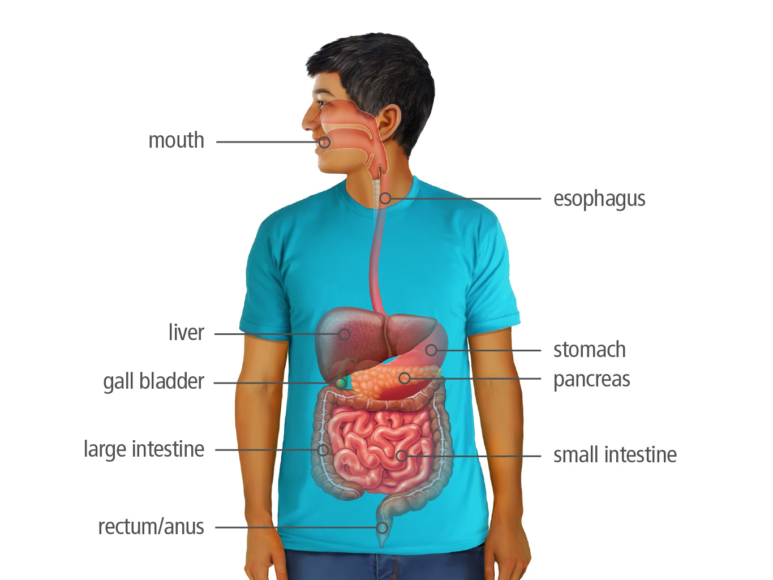
Unit 1 Lesson 2
Interacting Systems in Organisms
Organ systems can carry out complex functions because they are made up of organs that work together within the system.
An organ is a group of tissues that carry out a specialized function of the body.
How might the digestive system and the immune system interact to help protect the body?

Slide 7
Interacting Systems in Organisms Systems and System Models
Unit 1 Lesson 2
Make a simple flow chart to illustrate how the organs of the digestive system interact to help you digest food.

Slide 8
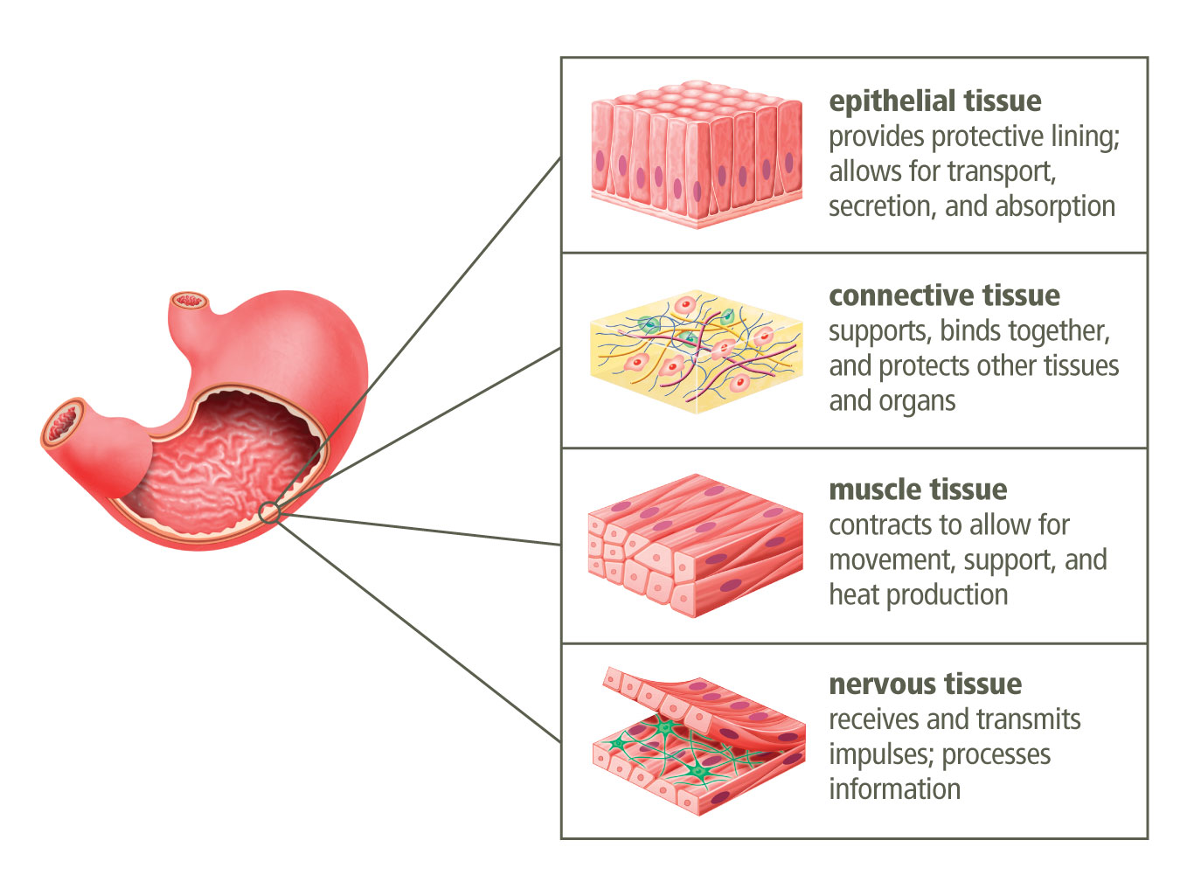
Interacting Systems in Organisms
Unit 1 Lesson 2
A tissue is a group of similar cells that work together to perform a specialized function, usually as part of an organ.
In the human body, organs are made up of four general types of tissues.

Slide 9
Unit 1 Lesson 2
Interacting Systems in Organisms
PREDICT
A tendon is a band of tissue that attaches a muscle to another body part such as a bone.
Which type of tissue would tendons most likely contain? Explain your answer.

Slide 10
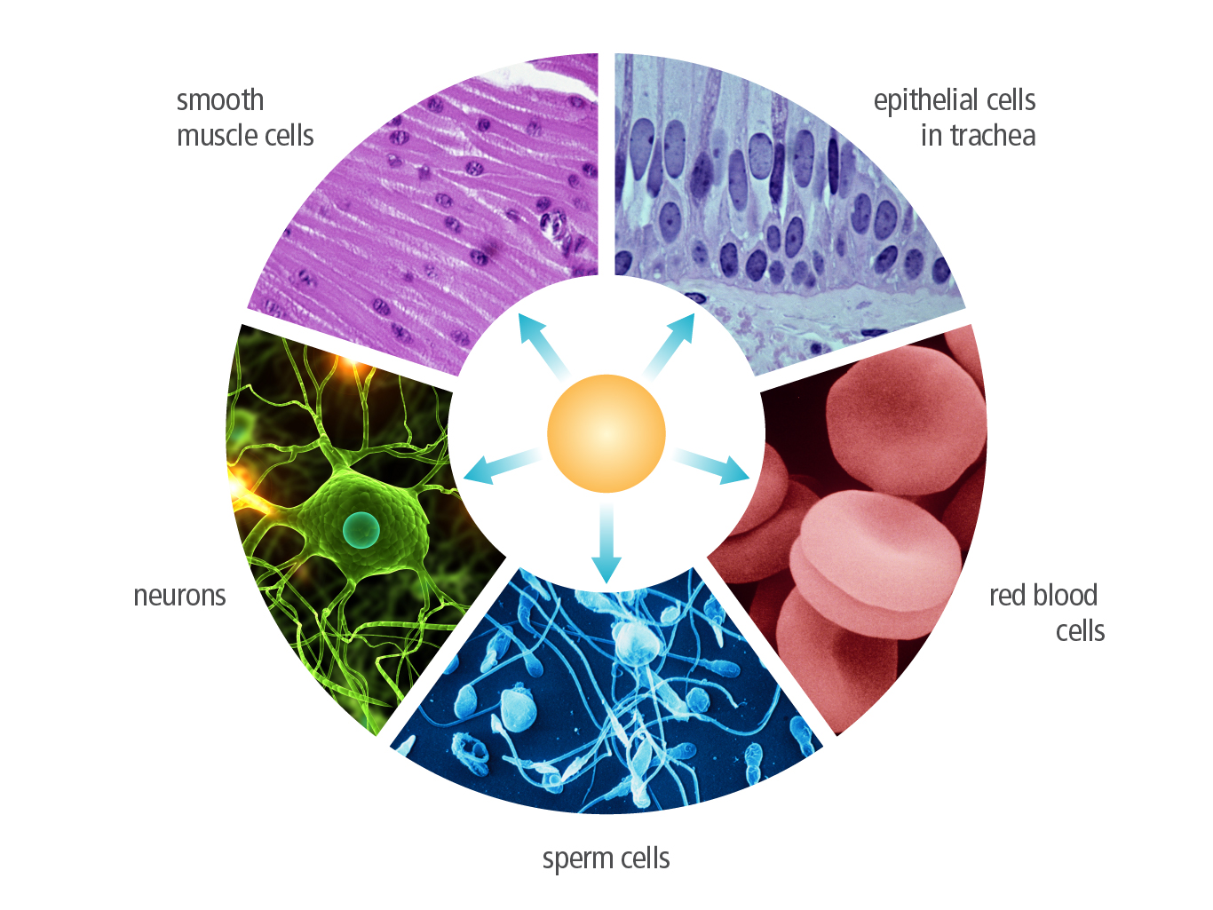
Unit 1 Lesson 2
Interacting Systems in Organisms
A cell is the most basic unit of life. The cells that make up an organism arise from a single cell that goes through successive divisions to make new cells.
Cell differentiation is the process by which cells become specialized in structure and function.

Slide 11
Interacting Systems in Organisms Engineering
Unit 1 Lesson 2
Nanobots are microscopic robots built on the scale of a nanometer.
Engineers are designing nanobots that can help deliver medicine, move through the bloodstream to hard-to-reach areas, and even destroy cancer cells.
Research a type of nanobot currently under development.
How did the purpose of the nanobot affect its design? List some structural features the design has or could have to complete its purpose.

Slide 12
Interacting Systems in Organisms Systems and System Models
Unit 1 Lesson 2
Draw a flow chart illustrating how the three types of neurons would interact to help a person pick up an object.

Slide 13
Unit 1 Lesson 2
Interacting Systems in Organisms
ANALYZE
Diseases such as multiple sclerosis cause the myelin sheath to break down.
How would the breakdown of myelin affect the functioning of a neuron?

Slide 14
Unit 1 Lesson 2
Interacting Systems in Organisms
MODEL
Construct a model to illustrate how the nervous and digestive systems might interact to produce the sensation of “butterflies" in your stomach.
Which organs are most likely involved, and how do they interact when you have this feeling?

Slide 15
Unit 1 Lesson 2
The Cell System
GATHER EVIDENCE
Make a table to record the name of each organelle or cell structure, its role in the cell system, and a simple visual or analogy representing that organelle.
As you read each section, complete the table.

Slide 16
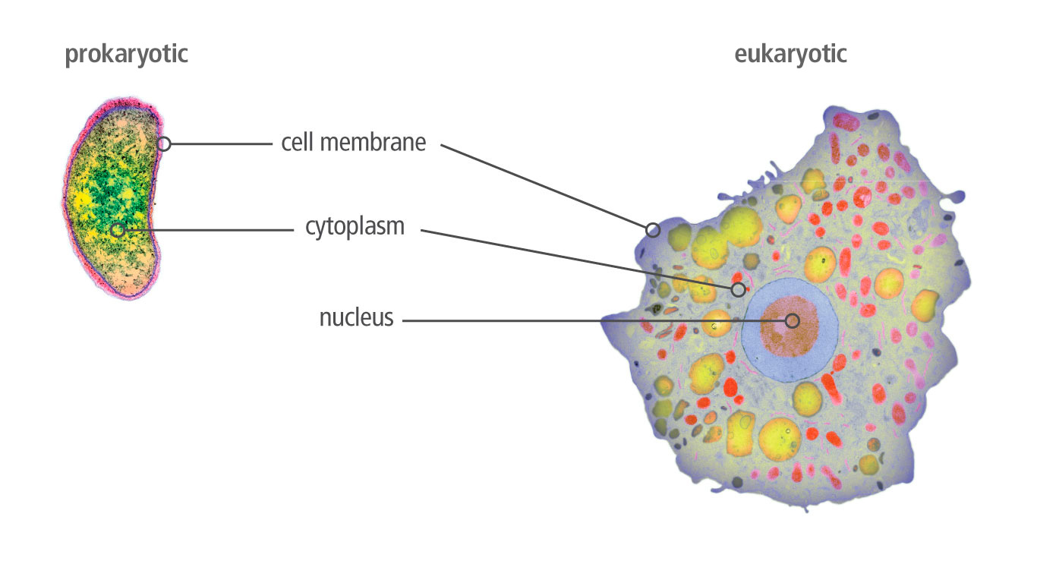
Unit 1 Lesson 2
The Cell System
All cells are enclosed by a cell membrane that controls the movement of materials into and out of the cell.
Inside the membrane, a cell is filled with cytoplasm.

Slide 17
Unit 1 Lesson 2
The Cell System
The nucleus is the storehouse for most of the genetic information, or DNA, in your cells.
A large part of the cytoplasm of most eukaryotic cells is filled by the endoplasmic reticulum.
The Golgi apparatus consists of stacks of membrane-enclosed spaces that process, sort, and deliver proteins.
The mitochondrion (plural: mitochondria) supplies energy to the cell.
Neurons have special proteins in their cell membranes that allow them to generate electric current. Are these proteins most likely produced by ribosomes on the rough ER or ribosomes suspended in the cytoplasm? Explain your answer.

Slide 18
The Cell System Structure and Function
Unit 1 Lesson 2
What purpose is served by controlled openings in the nuclear membrane?

Slide 19
The Cell System Hands-On Lab: Comparing Cells
Unit 1 Lesson 2
Use a microscope to investigate the similarities and differences between plant and animal cells.

Slide 20
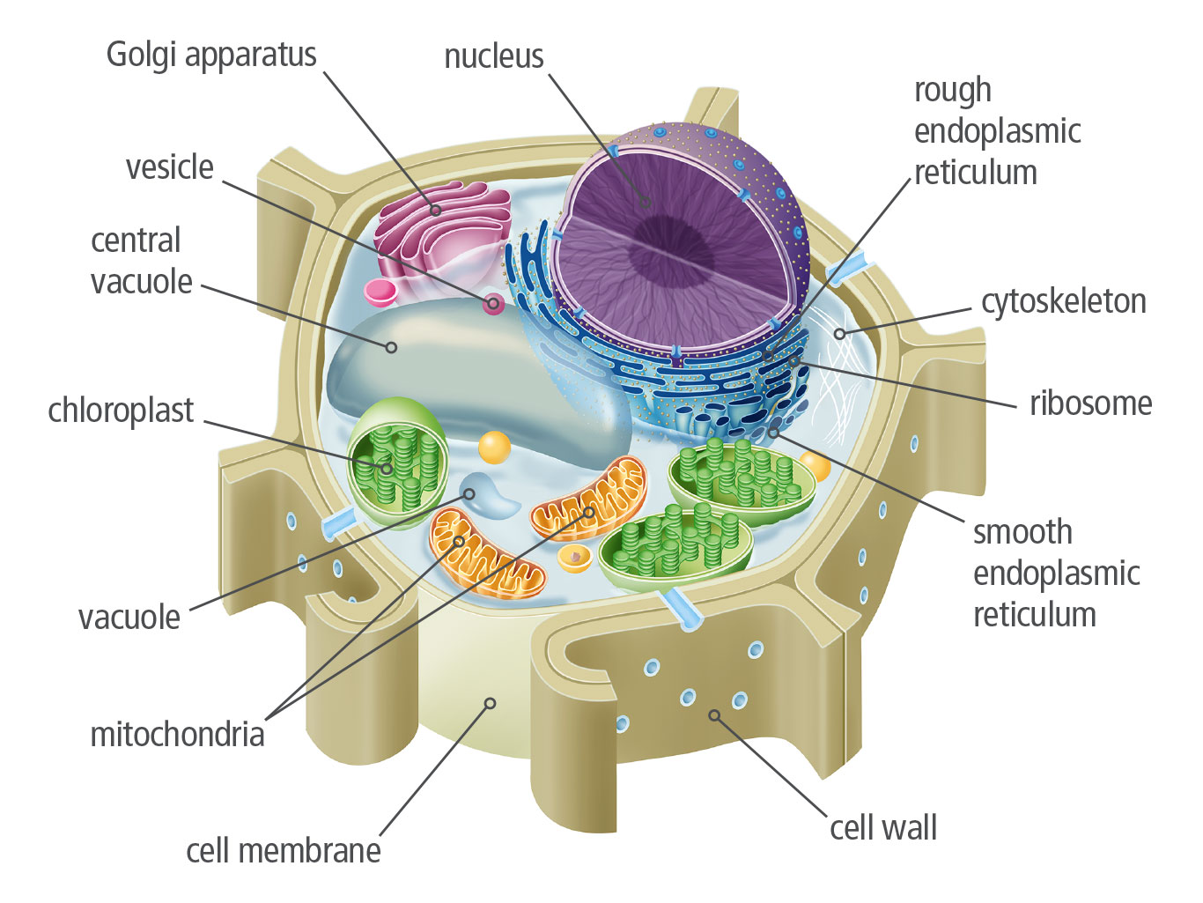
The Cell System
Unit 1 Lesson 2
Plant cells have specialized structures that protect the cell and capture energy.
Plants, algae, fungi, and most bacteria have a cell wall that surrounds the cell membrane.
Chloroplasts are organelles that carry out photosynthesis, a series of complex chemical reactions that convert light energy from the sun into energy-rich molecules the cell can use.
When a plant wilts, its leaves shrivel. How is this phenomenon related to the function of the vacuole in the plant system?

Slide 21
The Cell System
Unit 1 Lesson 2
EXPLAIN
What organelles do plant cells have that animal cells do not have?
What do you think is the function of each of these organelles?

Slide 22
The Cell System
Unit 1 Lesson 2
EXPLAIN
Make a claim for how the organization in eukaryotic cells allows these cells to perform specialized functions within an organism.
How do the components of the cell system interact to help it carry out specific tasks and interact with other systems in the body?
Use evidence and examples to support your claim.

Slide 23
Unit 1 Lesson 2
Continue Your Exploration
Choose one of the paths below to continue your exploration:
Plant Tissues and Cells
Modeling Interacting Body Systems
Comparing Prokaryotes and Eukaryotes

Slide 24
Can You Explain It?
Unit 1 Lesson 2
Use your model of the nervous and digestive systems and the evidence you have gathered in your Evidence Notebook to construct an explanation of how sensations, such as "butterflies" in the stomach, might arise. Which organs do you think are communicating, how are they communicating, and what is the function of this communication?
State your claim.
Summarize the evidence you have gathered to support your claim, and explain your reasoning.
Use your model to illustrate your claim. Revise the model as needed based on new evidence you gathered.

Slide 25
Image Credits
Unit 1 Lesson 2
cholera bacterium TEM ©Kari Lounatmaa/Science Source; protozoan ©LSHTM/Science Source; dancers backstage ©MUJAHID SAFODIEN/AFP PHOTO/Getty Images

